Slide 1
Monolith to microservices
Lessons learned from workshop Sam Newman
NDC Oslo 2019
Notes:
Ik heb iets geleerd op die workshop!
conceptueel!
Niet zeker weten, gewoon aankaarten.
Vanuit brownfield application

Slide 2

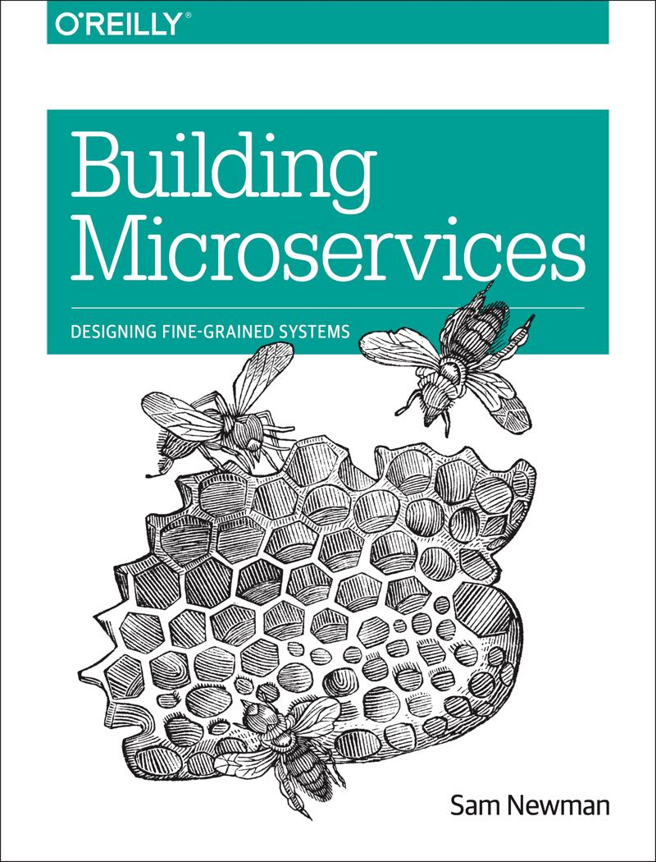
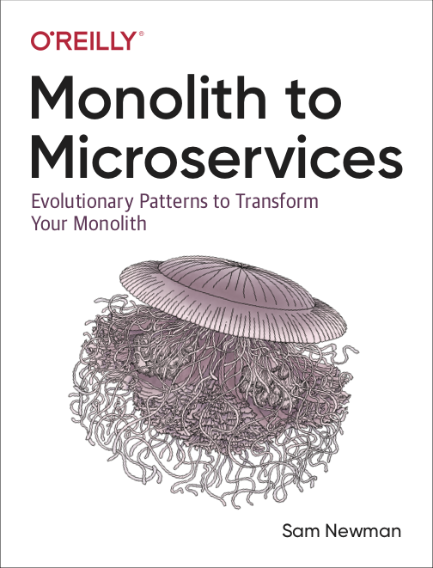
Who is Sam Newman?
Consultant, trainer, author & speaker

Slide 3
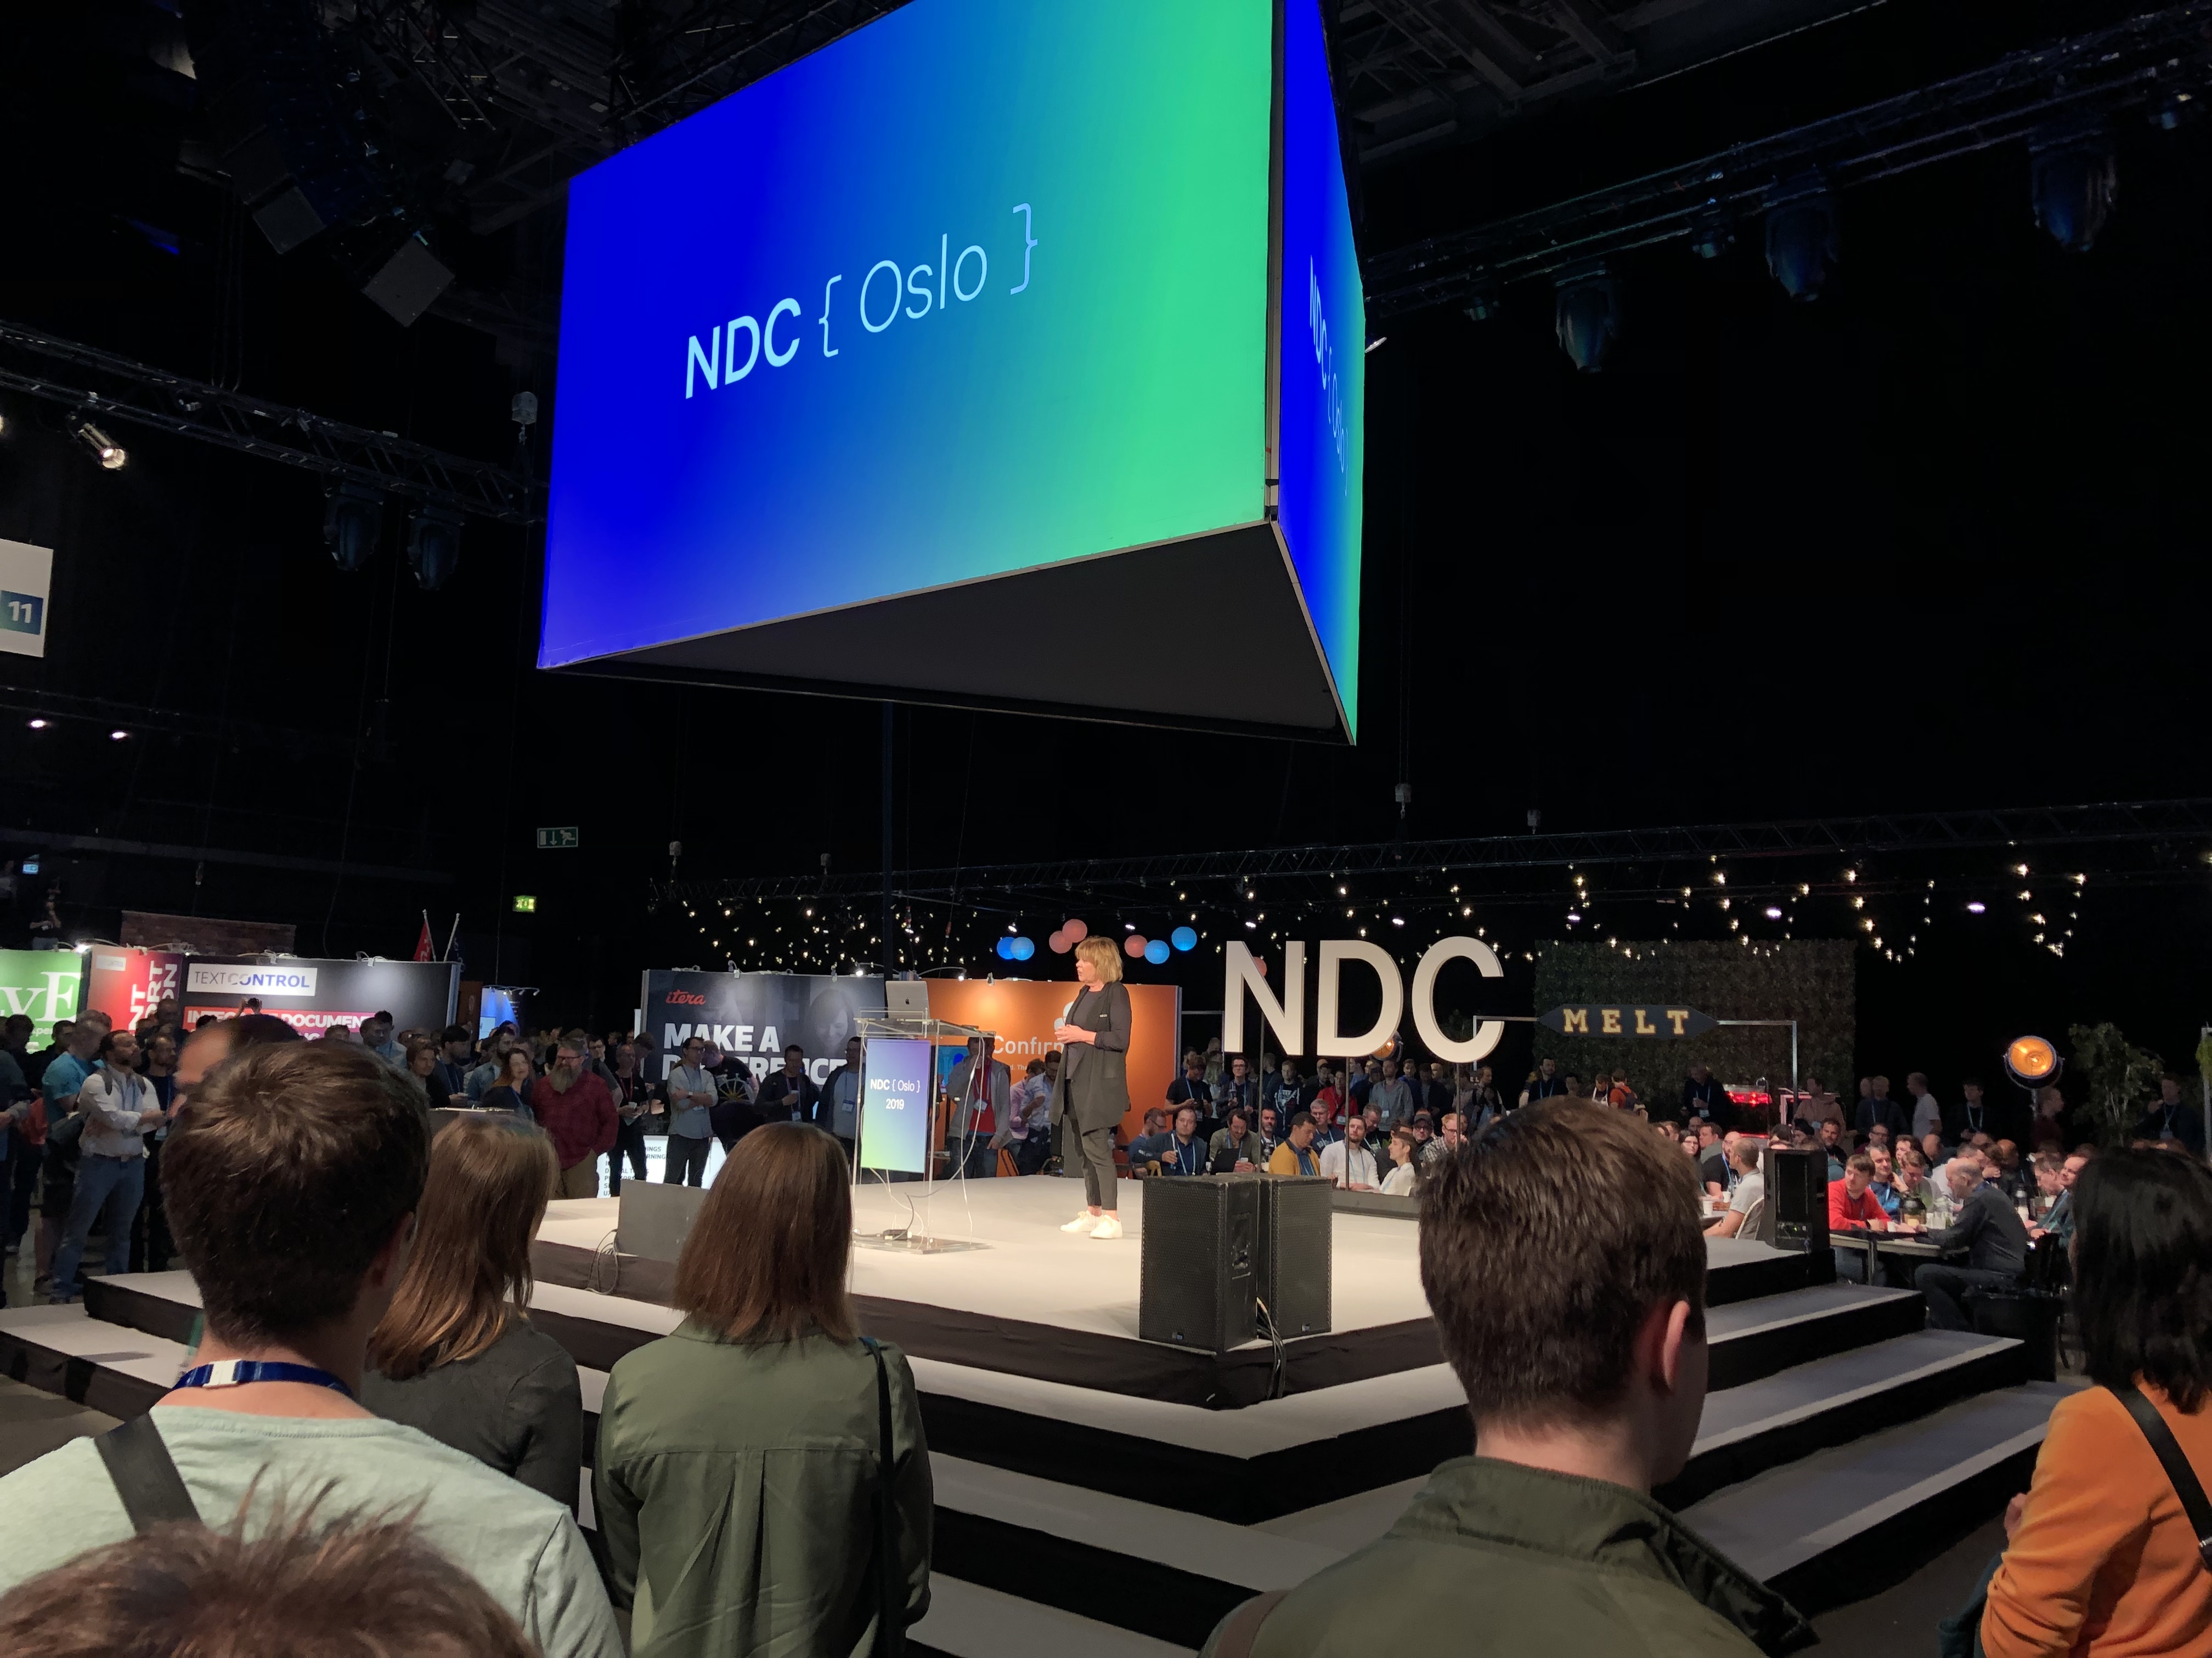
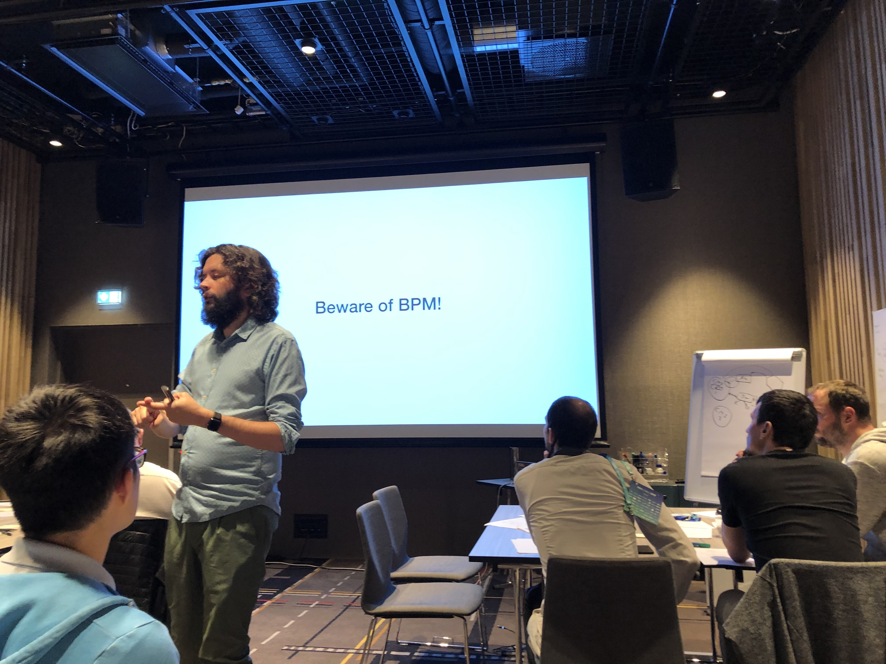
Workshop Monolith to microservices NDC Oslo 2019

Slide 4
What is microservices?
Notes:
“New” technologies
Cloud
.NET Core
gRPC
Containerization (Dockers)
Serverless
Service mesh

Slide 5
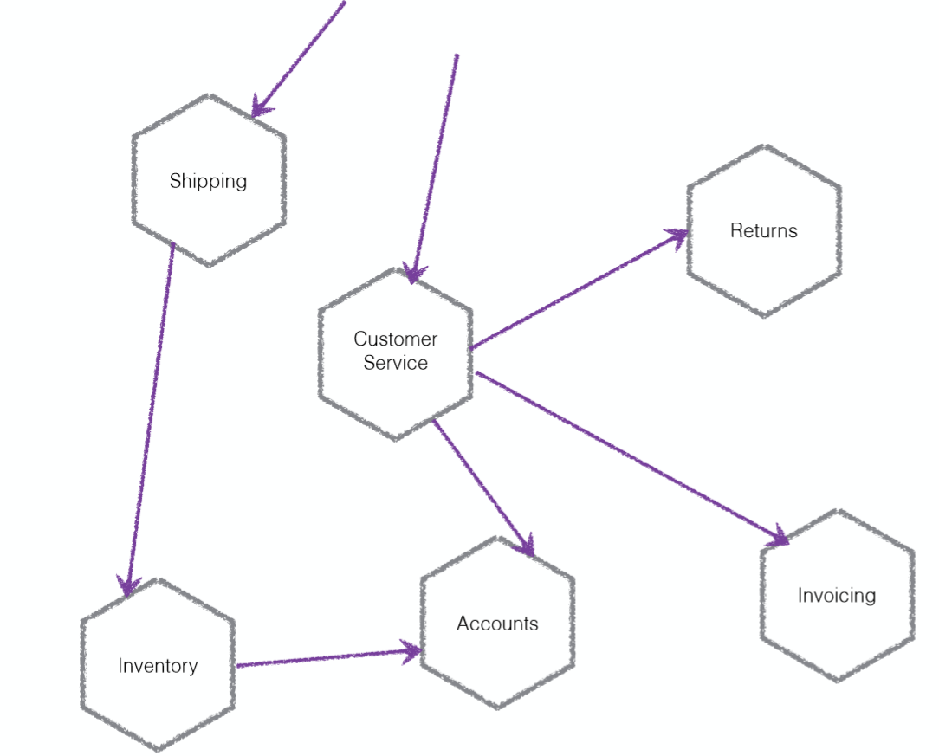
What is microservices?

Slide 6
What is microservices?
Small Independently Deployable services work together, modelled around a business domain
Notes:
Small?
Independently deployable?
Work together?
Business domain?

Slide 7
Principles microservices
Microservices
Modelled around business concepts
Culture of automation
Hide internal implementation details
Decentralize all the things
Deploy independently
Isolate failure
Highly observable
Notes:
Model around business concepts- Stable interfaces then technical concepts; Use Bounded contexts to define potential domain boundaries
Culture of automation – To deal with lot of microservices; Continuous delivery, test automation, environment definitions (dsc)
Hide internal implementations – Maximize the ability of one service to evolve independently of others; Modeling bounded contexts can help, as this helps us focus on those models that should be shared, and those that should be hidden
Decentralize all the things - Teams more self service (deployment, development and testing); Teams own their services; Architecture: avoid enterprise service bus & orchestrations.
Deploy Independently – deployed by themselves; even breaking changes ➔ use co-exists versioned endpoints
Isolate failure – Prevent cascading failures. Resiliency; antifragility;
Highly observable – Holistic view of the system

Slide 8
Microservices
Benefits:
Organizational alignment
Release functionality faster
Independent scaling
Easier focus on security concerns
Adopt technology faster
Embrace uncertainty in digital
Downsides:
More choices to make
Have a lead time
Testing is harder
Monitoring is more involved
Operational overhead
Notes:
Technology & tooling choices
Integration options
Number of services overload.
Testing complicated
Complexity!
Set up ease of deployment & monitoring of services

Slide 9

New kid on the block?

Slide 10
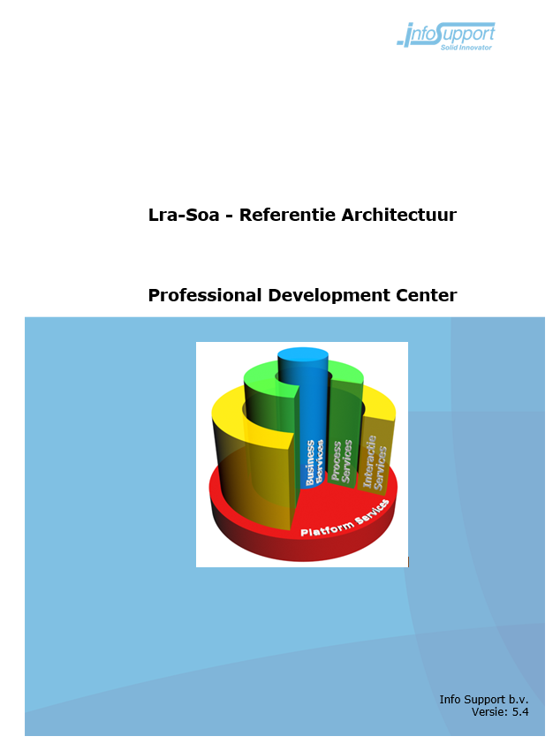
Service Oriented Architecture (Endeavour)
Architectuur principes:
Services zijn autonoom & onafhankelijk
Scheiding van processen en gegevensbeheer
Eenduidig eigenaarschap & mandaat
Abstractie van bestaande systemen en standaard pakketten
Bus structuur voor communicatie tussen componenten
Communicatie op basis van standaarden

Slide 11

Service Oriented Architecture

Slide 12
Microservices vs SOA
SOA
Enterprise Servicebus
Canonical schema’s
Microservices
Hexagonal architecture (ports & adapters)
Polyglot environment
Microservices = SOA done right
Notes:
SOA is een kapstok voor microservices. Aka microservices implementeert SOA of SOA done right.
Polyglot ➔ op gebied van concepten voornamelijk (Indien nodig!) voorbeeld nosql/event sourcing

Slide 13
Monoliths

Slide 14
Monoliths
Monolith
Clear choices
Single deployment
Vertical scaling

Slide 15

Monoliths – Big ball of mud
Notes:
Vervelende eigenschap in de IT Wereld ➔ Het veranderd steeds ➔ changing business requirements & team
Onduidelijk verantwoordelijkheden bij de modules/classes ➔ Resulteert in spaghetti code

Slide 16
Monoliths – Distributed

Slide 17
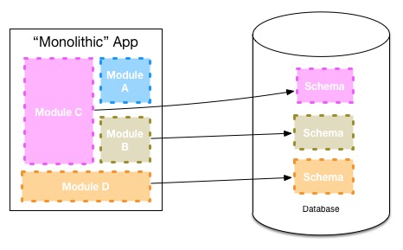
Monoliths – Modular
Notes:
Kwaliteit van software ➔ Loosy coupling
Verschil deployment model
Eerste stappen naar microservices architectuur

Slide 18
Monoliths are bad?
Well, it depends!
Deployment at customer locations
Startup/ green field system (unstable boundaries)
Notes:
Refactoring is makkelijker binnen een monoliet indien nodig.
Hoe je beter je de business al kent ➔ kan je vrij snel starten met microservices
https://samnewman.io/blog/2015/04/07/microservices-for-greenfield/

Slide 19


Monolith to microservices – GO!
Notes:
Hoe dan?

Slide 20

Define domain boundaries
Identify events
Identify commands & actors
Group commands & events
Bounded contexts
Notes:
Define domain boundaries ➔ Multiple Bounded contexts; logical boundaries; defined by contract of a service
Domain experts!
Discussie over domeinen! Bepaal aggregaties;
Business capabilities

Slide 21
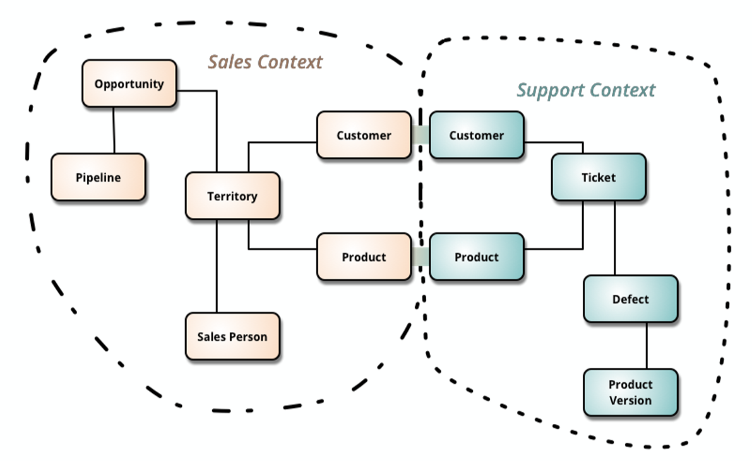
Define domain boundaries (bounded contexts)
Notes:
DDD

Slide 22
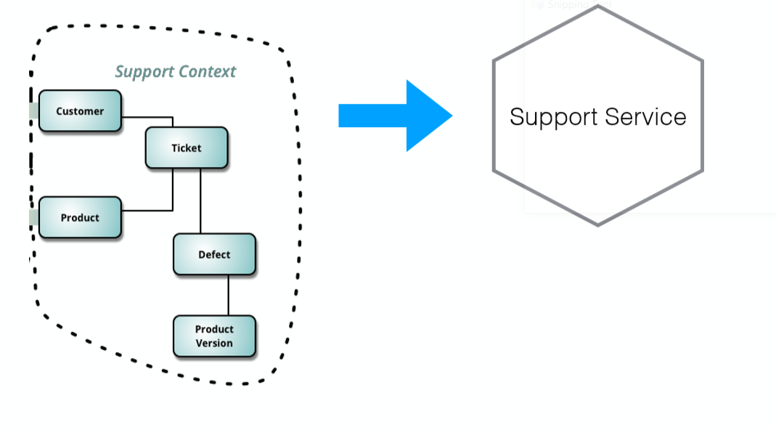
Bounded context ➔ Microservice
Notes:
Finer grainer? Notification/ ticketing?
https://particular.net/webinars/finding-your-service-boundaries-a-practical-guide

Slide 23
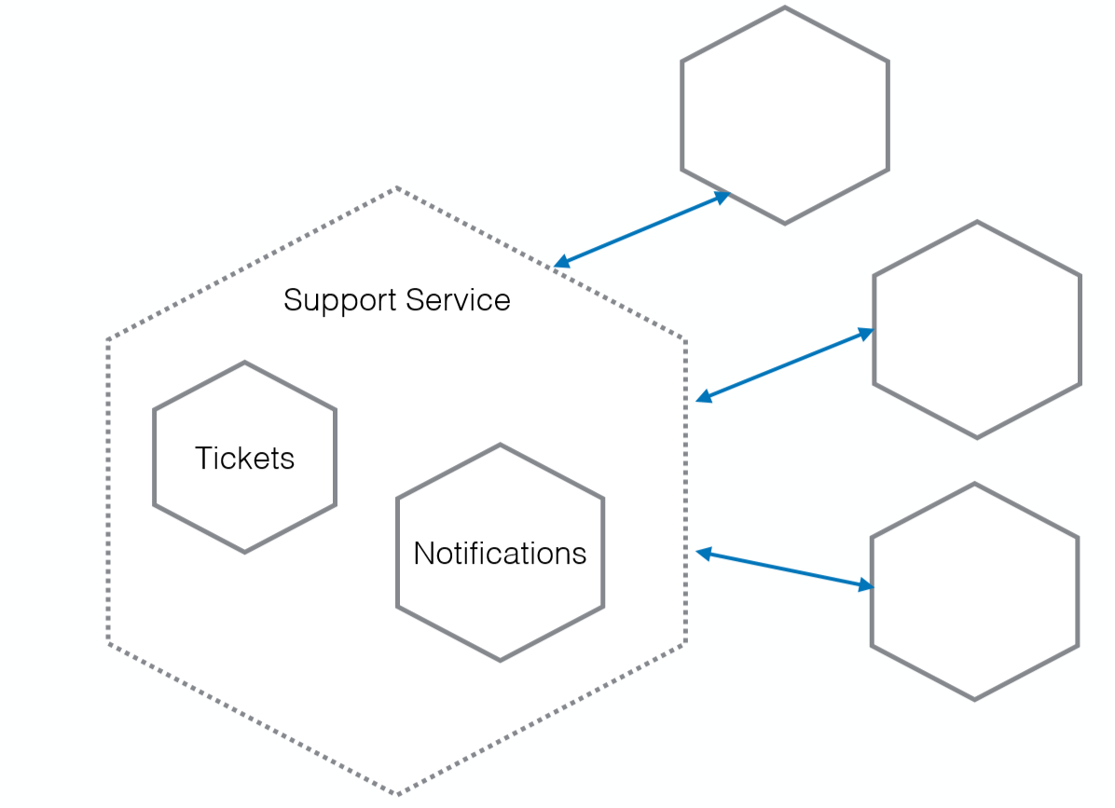
Can lead to finer grained

Slide 24
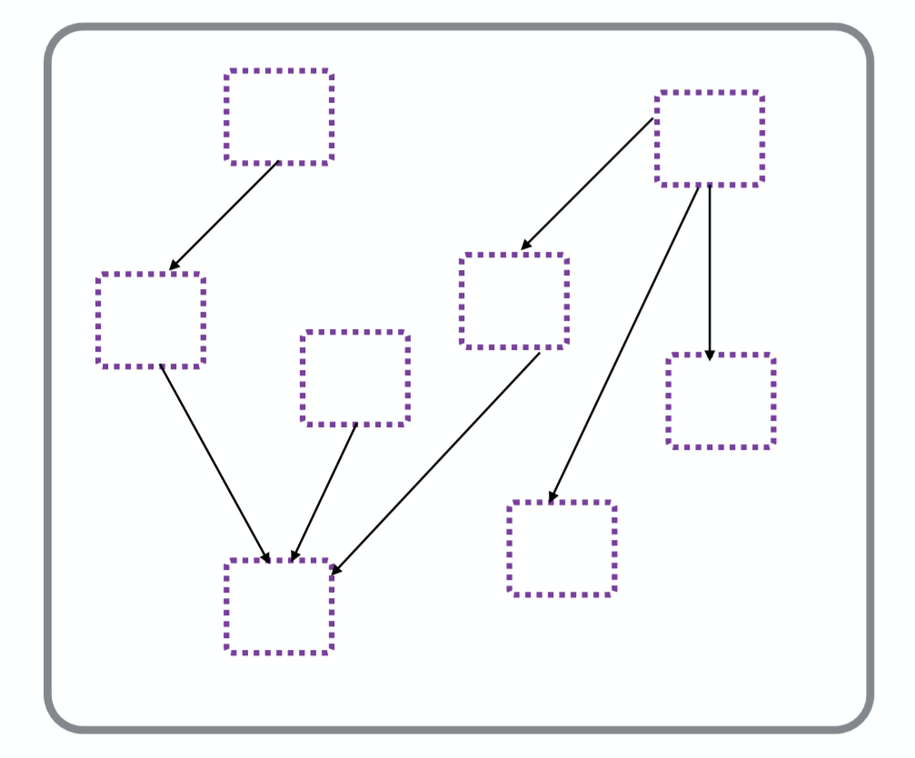
Where to start?

Slide 25
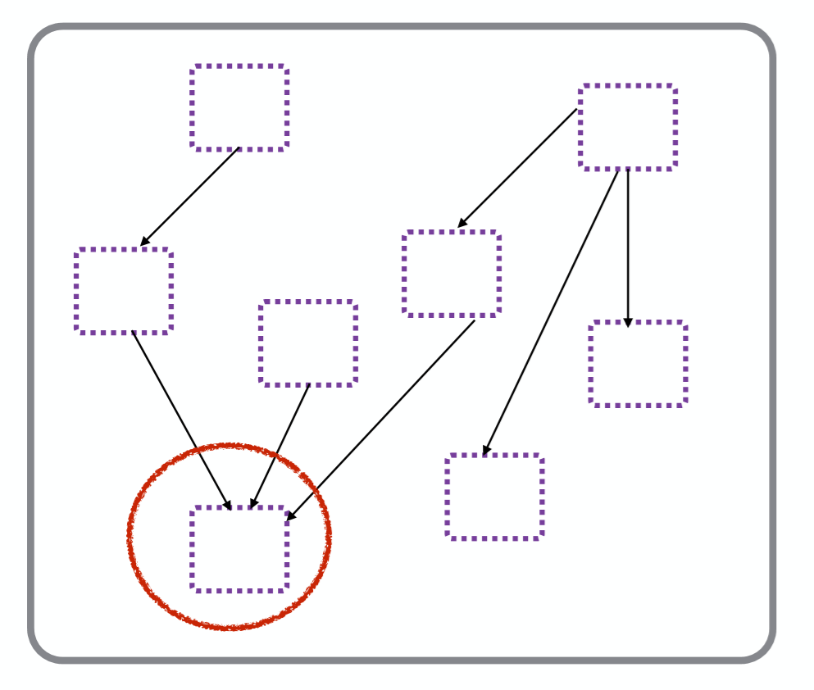
Where to start?

Slide 26
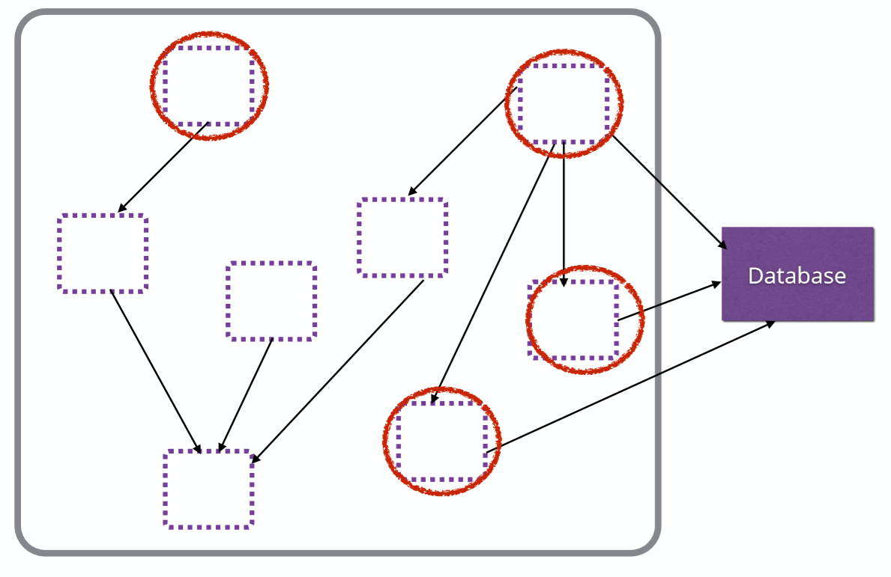
Where to start?

Slide 27
Where to start?
Good first microservice candidates:
Don’t have many inbound dependencies
Have a clear domain boundary
Are stateless

Slide 28
Where to start?
Ease Of Decomposition
VS
Benefits Of Decomposition
Notes:
Why are you doing this?
For time to market?
Look at code liveliness
Also check your backlog
Measure your cycle time as you go
For Scale?
identify your bottle necks
Continually measure

Slide 29
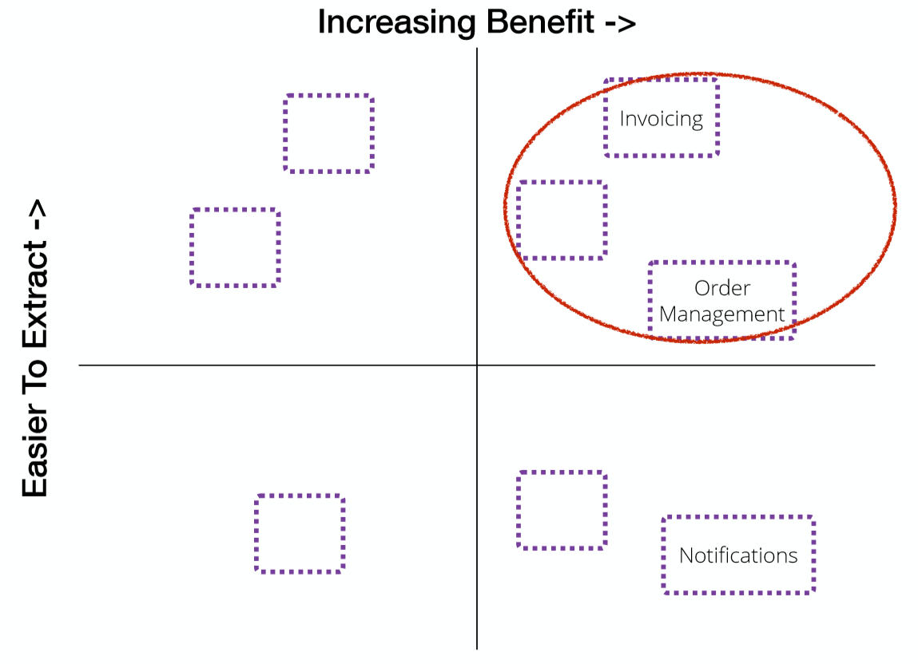
Where to start?

Slide 30
Incremental change
“If you do a big bang rewrite, the only thing you’re certain of is a big bang”
- Martin Fowler (paraphrased)
Notes:
Don’t just throw away existing tests!
Have tests to verify performance & regressions of your changes
continuous deliver business values

Slide 31

Strangler pattern
Notes:
https://en.wikipedia.org/wiki/Strangler_fig

Slide 32
Strangler pattern
Asset capture:
Identify the functionality to move to a new microservice
Redirect calls:
Intercept calls to old functionality and redirect to the new service

Slide 33
Proxy

Slide 34
HTTP Proxy
Existing monolith

Slide 35
HTTP Proxy
HTTP Proxy
Existing monolith

Slide 36
HTTP Proxy
HTTP Proxy
Existing monolith

Slide 37
Protocol changing proxy
RPC
Smart Proxy
RPC
HTTP
Existing monolith

Slide 38
Event decorating proxy
Smart Proxy
Existing monolith

Slide 39
Event decorating proxy
Smart Proxy
Existing monolith
Notes:
Works where you can map an inbound call to the event you want to ﬁre,
Sync
Voorkomen dat big bang
Naast laten lopen microservices

Slide 40
Change data capture

Slide 41
Change data capture
Existing monolith
DB

Slide 42
Change data capture
Existing monolith
DB
Notes:
Allows you to trigger behaviour based on any state change in the database
Inherently async

Slide 43
Branch by abstraction

Slide 44
Branch by abstraction
Invoicing
Orders
Notifications

Slide 45
Branch by abstraction
Invoicing
Orders
Interface
Notification Service
Notifications
Service Calling Implementation
Notes:
Canary testing
Live equivalence testing
Call both implementations & compare
Divert proportion of traffic to test new implementation (canary release)

Slide 46
Branch by abstraction
Invoicing
Orders
Interface
Notification Service
Notifications
Service Calling Implementation

Slide 47
Branch by abstraction
Invoicing
Orders
Notification Service
Service Calling Implementation
Notes:
Create abstraction point
Start work on new service implementation
Switch over
Cleanup

Slide 48
Err… Databases?

Slide 49
Accessing data
Existing monolith
DB
Notes:
Directy accessing but tight coupling

Slide 50
Avoid sharing databases
DB
DB

Slide 51
Expose data in the monolith
Existing monolith
API
DB
Notes:
This makes sense if the data belongs to the functionality that remains in the monolith
Deﬁning this API can help discover the scope of further services

Slide 52
Expose data in the monolith
Existing monolith
API
DB
Notes:
This makes sense if the data belongs to the functionality that remains in the monolith
Deﬁning this API can help discover the scope of further services

Slide 53
Expose data in the monolith
Existing monolith
API
DB
DB
Notes:
This makes sense if the data belongs to the functionality that remains in the monolith
Deﬁning this API can help discover the scope of further services

Slide 54
Split databases first?
Existing monolith
DB
Notes:
One Transactional Boundary
Single Database Call
Joins done in the DB

Slide 55
Split databases first?
Existing monolith
DB
DB
DB
Notes:
Broke transactional integrity
Two database calls
Some joins now done in application code
Distributed transactions

Slide 56
Split databases first?
Understand the performance and transactional integrity issues early

Slide 57
What about consistency?

Slide 58
Distributed transactions?
Transactionmanager (MSDTC)
Trying preserve consistent state over boundaries
Two phase commit
Not foolproof
Does not scale because of the locks!
Notes:
https://arnon.me/2010/09/soa-antipattern-transactional-integration/
https://exactly-once.github.io/posts/notes-on-2pc

Slide 59
Data consistency?
Avoid splitting data up (initial)
Move from technical view of the process (i.e. compensating transactions)
Services should have notion of eventual consistency
Avoid using distributed transactions (does not scale)
Determine per bounded context what consistency!
Notes:
Afhankelijk van business scenario’s bepaalde oplossing kiezen (niet one thing to rule them all)!

Slide 60
Shared static data
Use local storage per service
Treat as code
As a service

Slide 61
Front ends

Slide 62
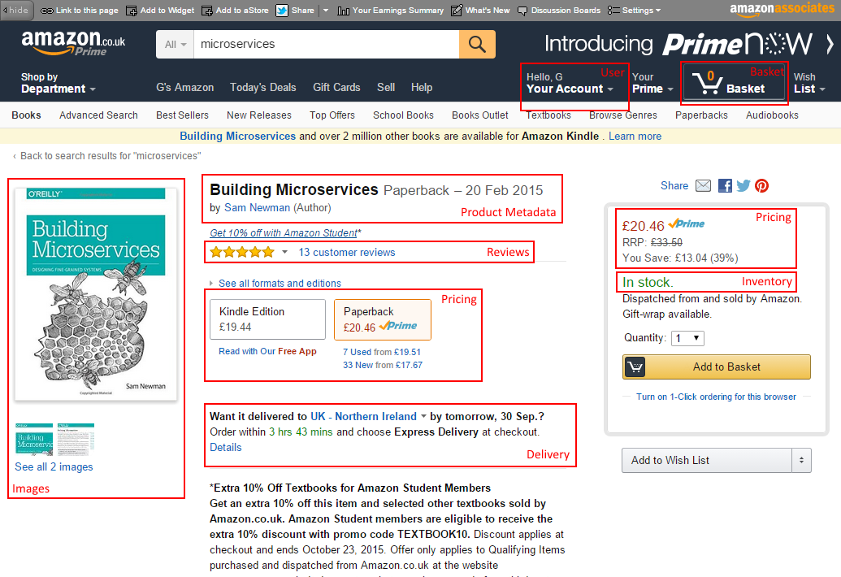
Composite UI
Notes:
Client side vs Server side

Slide 63
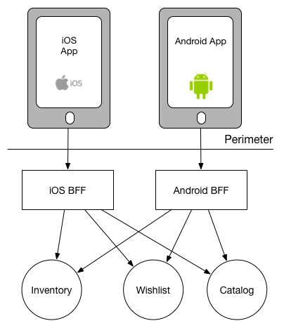
Backend For Frontends (BFF)

Slide 64
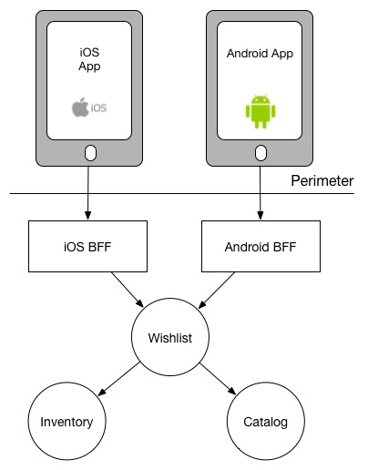
Backend For Frontends (BFF)

Slide 65
Wrap up
Have a good understanding about what you’re trying to achieve with your migration to microservices - this will determine how you carry out the migration
Incremental change is possible
Make sure you learn from each step you take - and adapt if required
It’s very rare that killing the monolith is what you need!

Slide 66
Questions?
Notes:
https://jimmybogard.com/my-microservices-faq/

